Slide 1

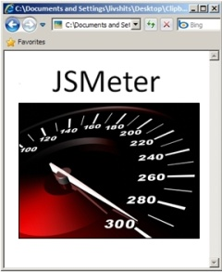
JSMeter: Characterizing the Behavior of
JavaScript Web Applications
Paruj Ratanaworabhan
Kasetsart University, Thailand
Ben Livshits and Ben Zorn
Microsoft Research, Redmond
in collaboration with
David Simmons, Corneliu Barsan, and Allen Wirfs-Brock

Slide 2
One Word:
Standard for scripting web applications
Fast JITs widely available
JavaScript
Lots of code present
in all major web sites
Support in every browser

Slide 3
Why Measure JavaScript?
Standardized, de facto language for the web
  Support in every browser, much existing code
Benchmarks are driving browser marketing: “browser wars”
  Are benchmarks representative?
  Limited understanding of its behavior in real sites
Who cares?
  Users, web application developers, JavaScript engine developers
Notes:
3

Slide 4
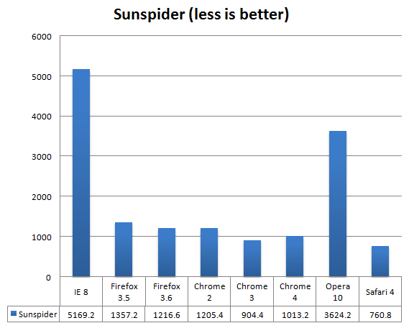
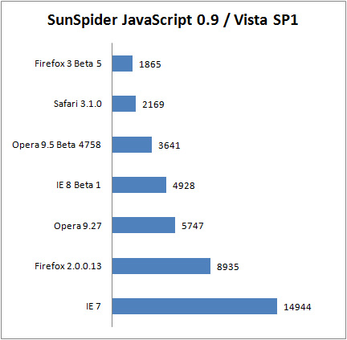
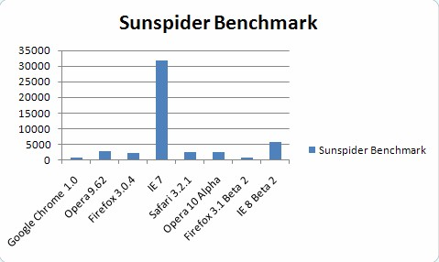
ZDNet 29 May 2008
Browser
Wars!
ghacks.net Dec. 2008

Slide 5










Artificial Benchmarks versus Real World Sites
7 V8 programs:
richards
deltablue
crypto
raytrace
earley-boyer
regexp
splay
8 SunSpider programs:
3-draytrace
access-nbody
bitops-nsieve
controlflow
crypto-aes
date-xparb
math-cordic
string-tagcloud
11 real sites:
JSMeter
Goals of this Talk
Show behavior of JavaScript benchmarks versus real sites
Consider how benchmarks can mislead design decisions
Maps
Maps

Slide 6



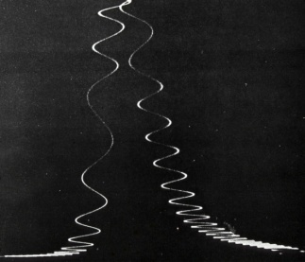


Instrumentation Framework
Source-level instrumentation
\ie\jscript\*.cpp
custom jscript.dll
website visits
custom trace files
Offline analyzers
custom trace files
Notes:
6

Slide 7
Visiting the Real Sites
Getting past page load performance
Attempted to use each site in “normal” way:
amazon | Search a book, add to shopping cart, sign in, and sign out
bing | Type in a search query and also look for images and news
bingmap | Search for a direction from one city to another
cnn | Read front page news
ebay | Search for a notebook, bid, sing in, and sign out
economist | Read front page news, view comments
facebook | Log in, visit a friend pages, browse through photos and comments
gmail | Sign in, check inbox, delete a mail, and sign out
google | Type in a search query and also look for images and news
googlemap | Search for a direction from one city to another
hotmail | Sign in, check inbox, delete a mail, and sign out

Slide 8
Understanding JavaScript Behavior
Code
Events
JavaScript
Objects

Slide 9
Code Behavior
Code
Events
JavaScript
Objects
Function size
Instructions/call
Code locality
Instruction mix

Slide 10
Total Bytes of JavaScript Source
Code|Objects|Events
Real Sites V8 SunSpider

Slide 11
Ratio of Bytecode / Source
Code|Objects|Events
Real Sites V8 SunSpider

Slide 12
Static Unique Functions Executed
Code|Objects|Events
Real Sites V8 SunSpider

Slide 13
Total Bytecodes Executed
Code|Objects|Events
90395
Real Sites V8 SunSpider

Slide 14
Total Function Calls
Code|Objects|Events
Real Sites V8 SunSpider

Slide 15
Bytecodes / Call
Code|Objects|Events
function(a,b) {
var i=0,elem,pos=a.length;
if(D.browser.msie) {
while(elem=b[i++])
if(elem.nodeType!=8)
a[pos++]=elem;
} else
while(elem=b[i++])
a[pos++]=elem;
return a
}
Real Sites V8 SunSpider

Slide 16
Fraction of Code Executed
Code|Objects|Events
Most code
not executed
Real Sites V8 SunSpider

Slide 17
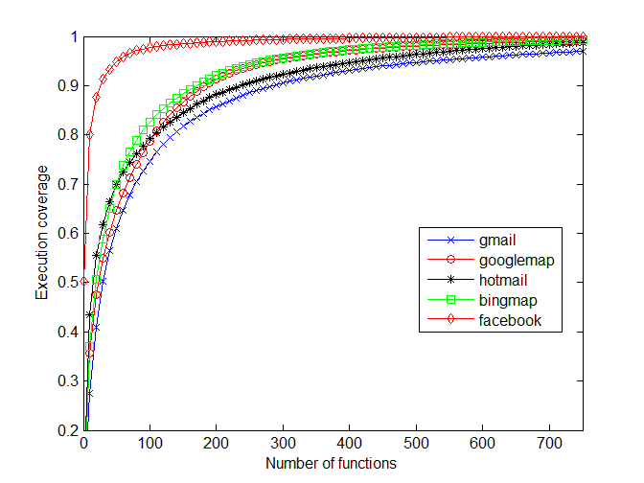
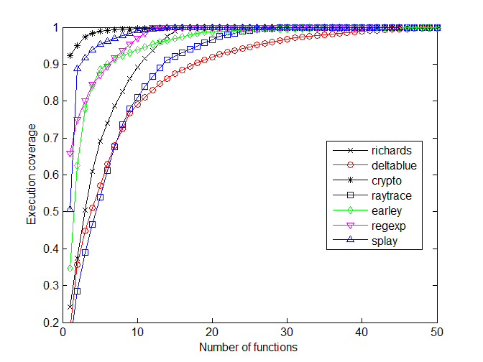
Hot Function Distribution
Code|Objects|Events
80% of time in 100+ functions
80% of time in < 10 functions
80%
80%
Real Sites
V8 Benchmarks

Slide 18
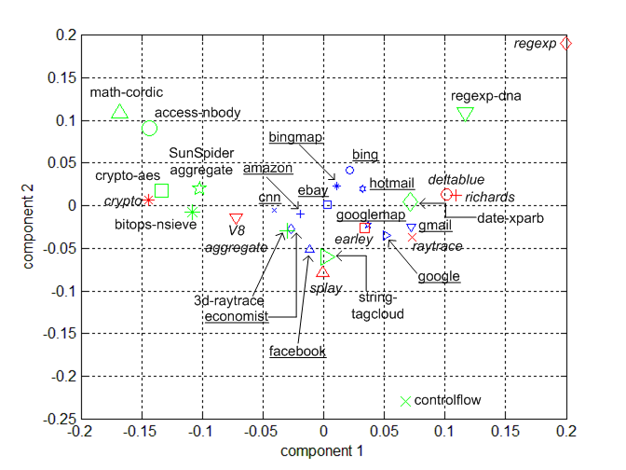
Opcode Distribution
Code|Objects|Events
Outliers
Real Apps
Green = SunSpider | Blue= Real Web Apps | Red = V8

Slide 19
Object Allocation Behavior
Code
Events
JavaScript
Objects
Allocation by types
Lifetime distribution
Live heap composition

Slide 20
Total Bytes Allocated
Code|Objects|Events
Real Sites V8 SunSpider

Slide 21
Heap Data by Type
Code|Objects|Events
Few benchmarks
allocate much data
Many functions
Rest are strings
Real Sites V8 SunSpider

Slide 22
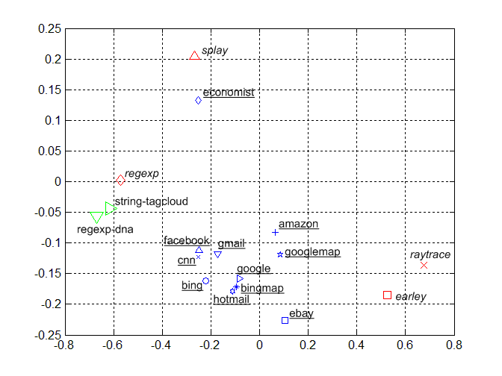
Object Type Distribution
Code|Objects|Events
Real Apps
economist
is an outlier
(arrays)

Slide 23
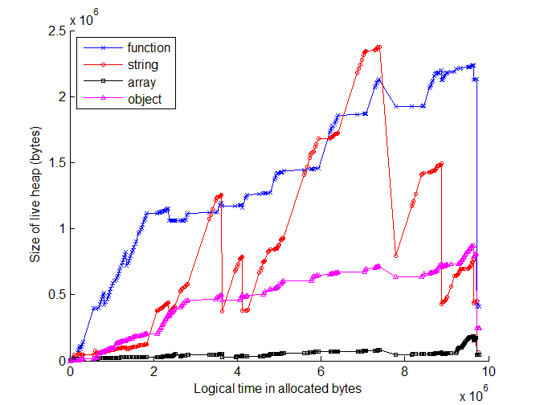
Live Heap Over Time (gmail)
Code|Objects|Events
Functions grow
steadily
GC reduces
size of heap
Objects grow
steadily too

Slide 24
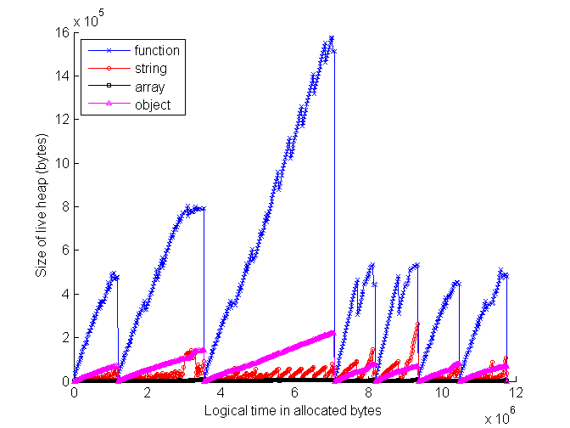
Live Heap over Time (ebay)
Code|Objects|Events
Heaps
repeatedly
created,
discarded
Heap contains
mostly functions
Heap drops to 0
on page load

Slide 25
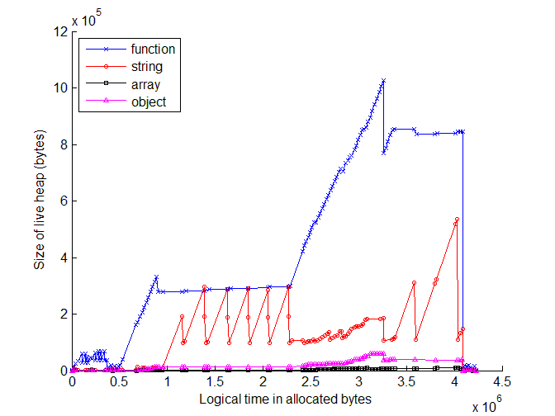
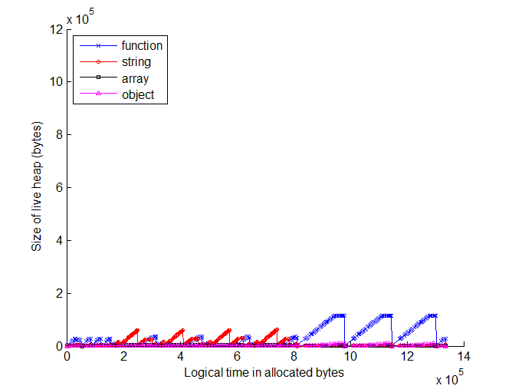
2 Search Websites, 2 Architectures
Code|Objects|Events
You stay on the same page
during your entire visit
Code loaded once
Heap is bigger
Every transition loads a
new page
Code loaded repeatedly
Heap is smaller
Bing
(Web 2.0)
Google
(Web 1.0)

Slide 26
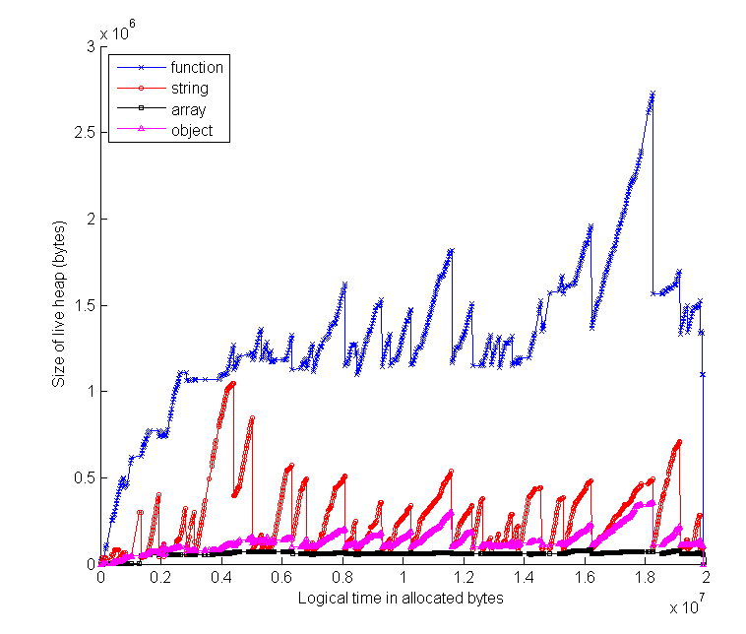
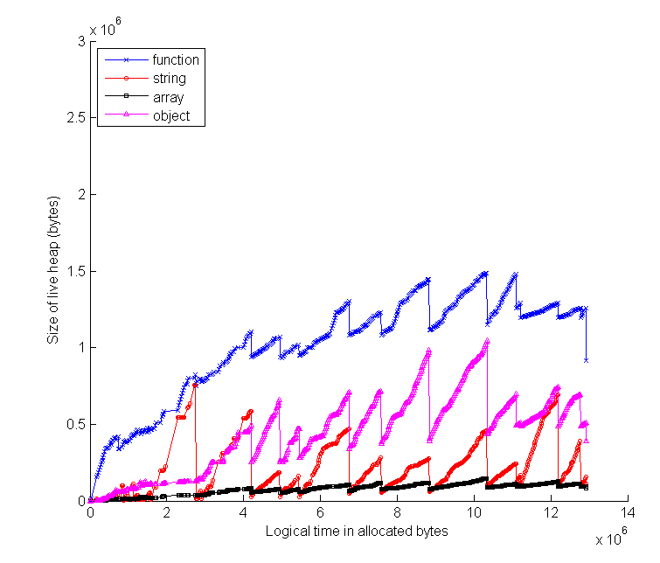
Two Mapping Websites
Code|Objects|Events
Bing Maps
Google Maps

Slide 27
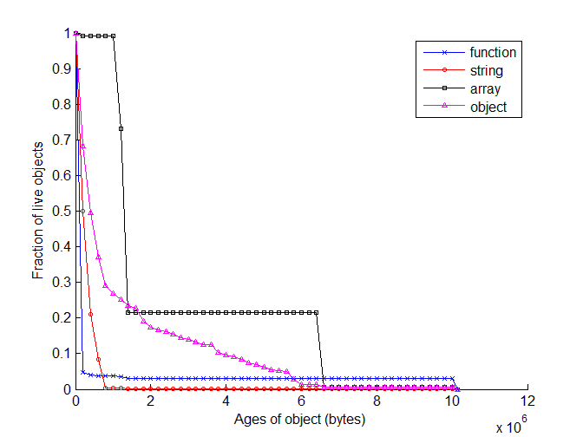
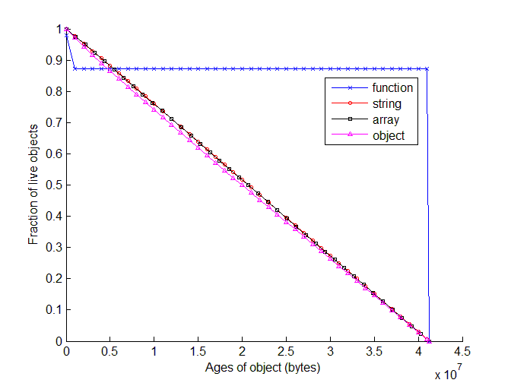
Object Lifetimes (V8)
Code|Objects|Events
Lives forever
Lives until
program ends
Dies
immediately
earley
splay

Slide 28
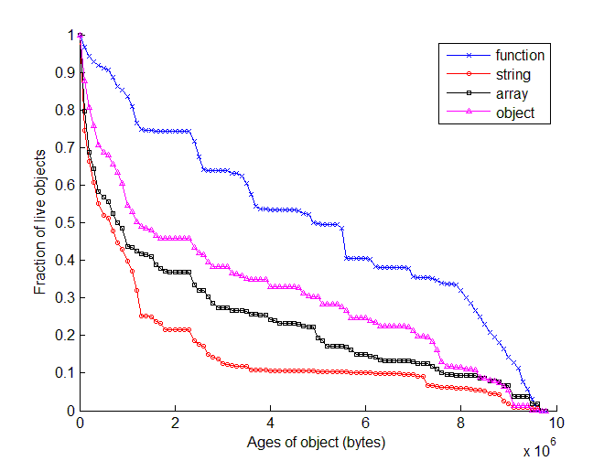
Object Lifetimes (gmail)
Code|Objects|Events
Many objects
live a major
fraction of
page lifetime
Functions are
longest lived
This is as old
as an object
can be
Strings are
shortest lived

Slide 29
Event Handlers in JavaScript
Code
Events
JavaScript
Objects
Number of events
Sizes of handlers

Slide 30
Event-driven Programming Model
Code|Objects|Events
Single-threaded, non-preemptive event handlers
Example handlers: onabort, onclick, etc.
Very different from batch processing of benchmarks
Handler responsiveness critical to user experience

Slide 31
Total Events Handled
Code|Objects|Events
Almost no events
Real Sites V8

Slide 32
Average Bytecodes / Event Handled
Code|Objects|Events

Slide 33
Median Bytecodes / Event Handled
Code|Objects|Events
506
2137

Slide 34
Maximum Bytecodes / Event Handled
Code|Objects|Events

Slide 35
Fraction of Execution in Handlers
Code|Objects|Events

Slide 36
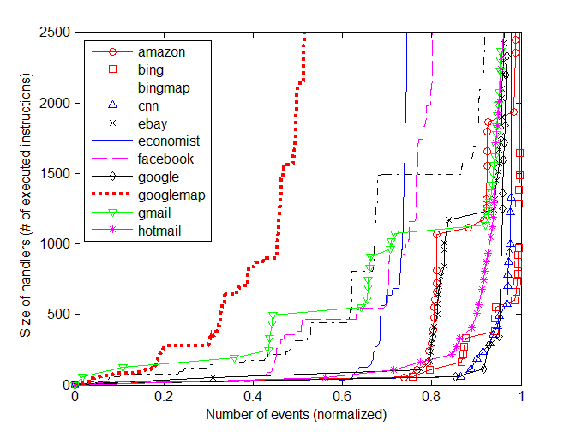
Distribution of Time in Handlers
Code|Objects|Events

Slide 37
Cold-code Experiment
Observation
  Real web apps have lots of code (much of it cold)
  Benchmarks do not
Question: What happens if the benchmarks have more code?
  We added extra, unused to code to 6 SunSpider benchmarks
  We measured the impact on the benchmark performance

Slide 38
Performance Impact of Cold Code
Without cold code,
Chrome12x faster than IE8
With 2M cold code,
Chrome 4.7x faster than IE8
Which comparison is more meaningful?
Chrome
IE 8
Cold code makes
SunSpider on Chrome
up to 4.5x slower
Cold code has
non-uniform impact
on execution time

Slide 39
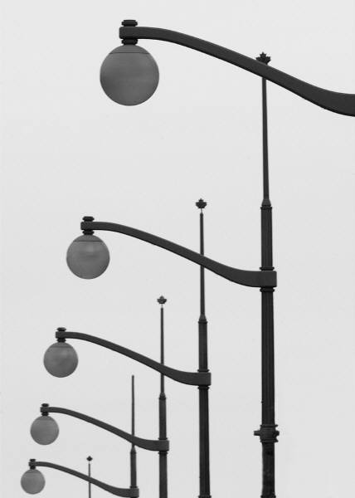
Impact of Benchmarks
What gets emphasis
  Making tight loops fast
  Optimizing small amounts of code
Important issues ignored
  Garbage collection (especially of strings)
  Managing large amounts of code
  Optimizing event handling
  Considering JavaScript context between page loads

Slide 40
Conclusions
JSmeter is an instrumentation framework
  Used to measure and compare JavaScript applications
  High-level views of behavior promote understanding
Benchmarks differ significantly from real sites
  Misleads designers, skews implementations
Next steps
  Develop and promote better benchmarks
  Design and evaluate better JavaScript runtimes
  Promote better performance tools for JavaScript developers

Slide 41
Conclusions
JSmeter is an instrumentation framework
  Used to measure and compare JavaScript applications
  High-level views of behavior promote understanding
Behavior in benchmarks significantly differs from real sites
  Misleads designers, skews implementations
Next steps
  Develop and promote better benchmarks
  Design and evaluate better JavaScript runtimes
  Promote better performance tools for JavaScript developers

Slide 42
Additional Resources
Project: http://research.microsoft.com/en-us/projects/jsmeter/
Video: Project JSMeter: JavaScript Performance Analysis in the Real World" - MSDN Channel 9 interview with Erik Meier, Ben Livshits, and Ben Zorn
Papers:
  “JSMeter: Comparing the Behavior of JavaScript Benchmarks with Real Web Applications”, Paruj Ratanaworabhan, Benjamin Livshits and Benjamin G. Zorn, USENIX 2010 Conference on Web Application Development (WebApps’10), June 2010.
  "JSMeter: Characterizing Real-World Behavior of JavaScript Programs", Paruj Ratanaworabhan, Benjamin Livshits, David Simmons, and Benjamin Zorn, MSR-TR-2009-173, December 2009 (49 pages), November 2009.

Slide 43
Additional Slides

Slide 44
Related Work
JavaScript
  “An Analysis of the Dynamic Behavior of JavaScript Programs”, Gregor Richards, Sylvain Lebresne, Brian Burg, Jan Vitek, PLDI 2010, June 2010/
C# and Java
  Doufour
C++
  Calder et al.

